Slide 1
TEHNOLOGII WEB
antohi.ionel@gmail.com

Slide 2
GETTING STARTED
Introduction
How Did We Do?
Project Organization
Top Issues Facing In Visual Studio 2015-2017
Project References (NuGet Packages)
Project Configuration
First Run

Slide 3
Introduction
In this course we'll provide an introduction to ASP.NET MVC by creating an application that uses the Entity Framework and Entity Framework migrations to read and update data in SQL Server, then deploy the application to a Windows Server 2012 web site. We'll also drill into new features for version 4 of ASP.NET MVC. We'll look at async controller actions and the new Task based programming model, and build a Web API to consume with JavaScript and jQuery. The course also covers the bundling and minification features included with the System.Web.Optimization package, and the new mobile development features including display modes and browser overrides.

Slide 4
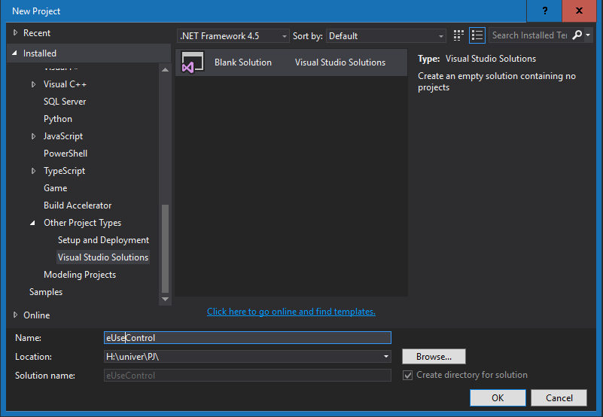
SOLUTION SETUP
1. File > New > Project…
2. Other Project Types > Visual Studio Solution
3. Give a project name.
Note: We will use .NET Framework 4.5

Slide 5
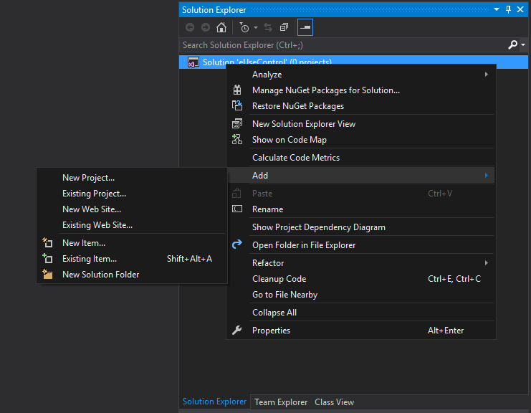
ADD PROJECT TO SOLUTION
R-Click on Solution ADD NEW PROJECT…

Slide 6
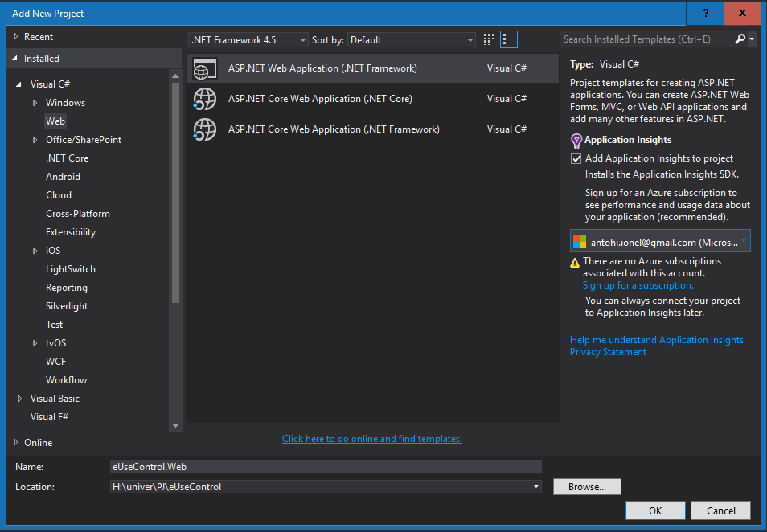
WEB PROJECT
1.Visual C# 2.Web
3.ASP.NET Web Application (.NET Framework)
Note
Save Solution name as main namespaces ex:
eUseControl.[project name]

Slide 7
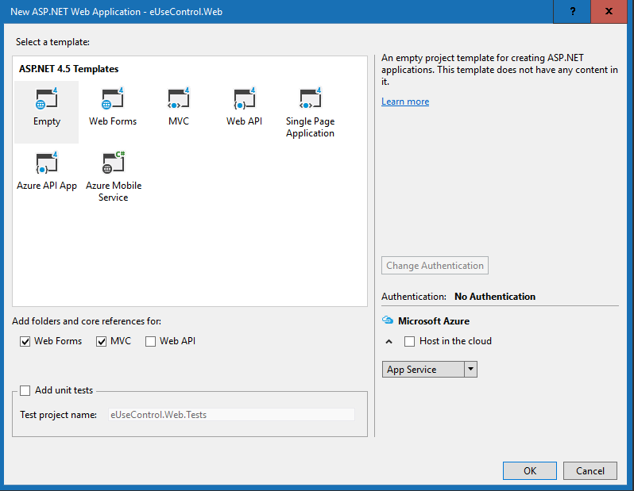
PROJECT TEMPLATES

Slide 8
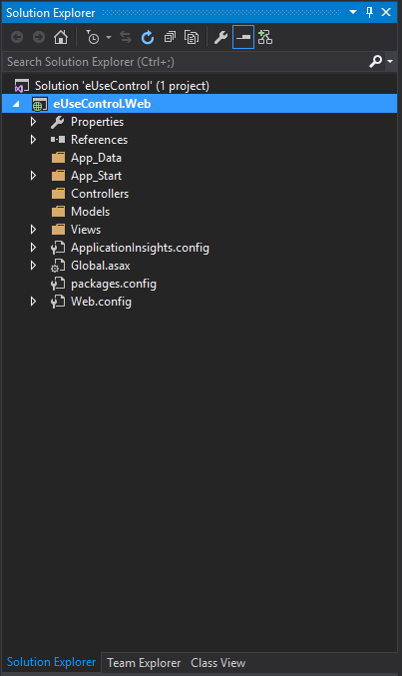
PROJECT TREE
Controllers - MVC controllers are responsible for responding to requests made against an ASP.NET MVC website. Each browser request is mapped to a particular controller.
Views - A view is a standard (X)HTML document that can contain scripts. You use scripts to add dynamic content to a view.
Models - In the ASP.NET MVC framework, the model is the part of the application that is responsible for the core application or business logic.

Slide 9
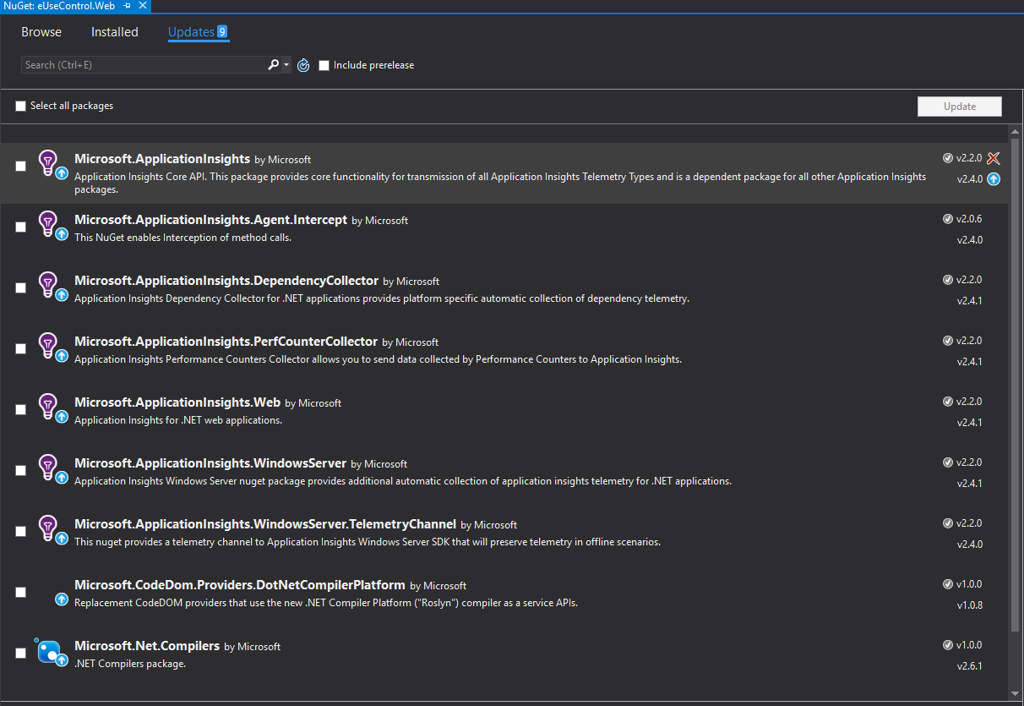
UPDATES

Slide 10
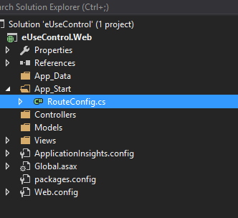
APP ROUTE
ASP.NET introduced Routing to eliminate needs of mapping each URL with a physical file. Routing enable us to define URL pattern that maps to the request handler. This request handler can be a file or class. In ASP.NET Webform application, request handler is .aspx file and in MVC, it is Controller class and Action method. For example, http://domain/students can be mapped to http://domain/studentsinfo.aspx in ASP.NET Webforms and the same URL can be mapped to Student Controller and Index action method in MVC.

Slide 11
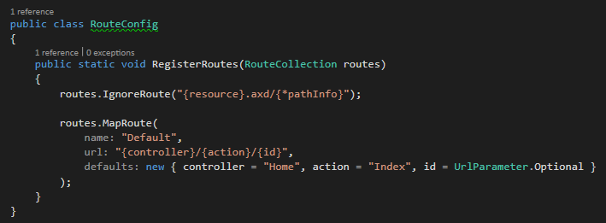
APP ROUTE
Route format:
Controller – is the same as Class defined in Controllers folder.
Action – is the Method declared in Controller Class.
Id – is additional parameter.

Slide 12
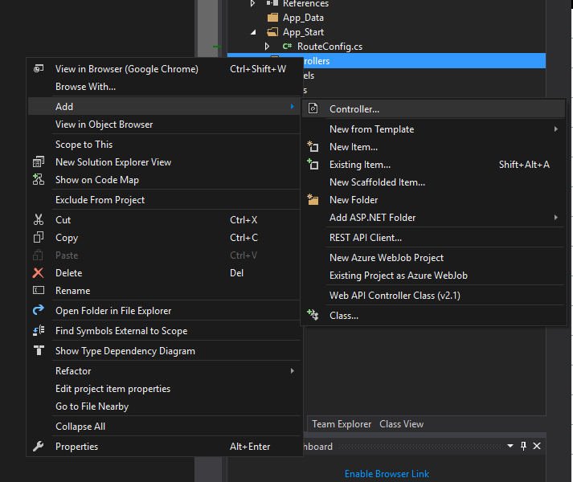
ADD CONTROLLER
The easiest way to create a new controller is to right-click the Controllers folder in the Visual Studio Solution Explorer window and select the Add, Controller menu option. Selecting this menu option opens the Add Controller dialog.

Slide 13
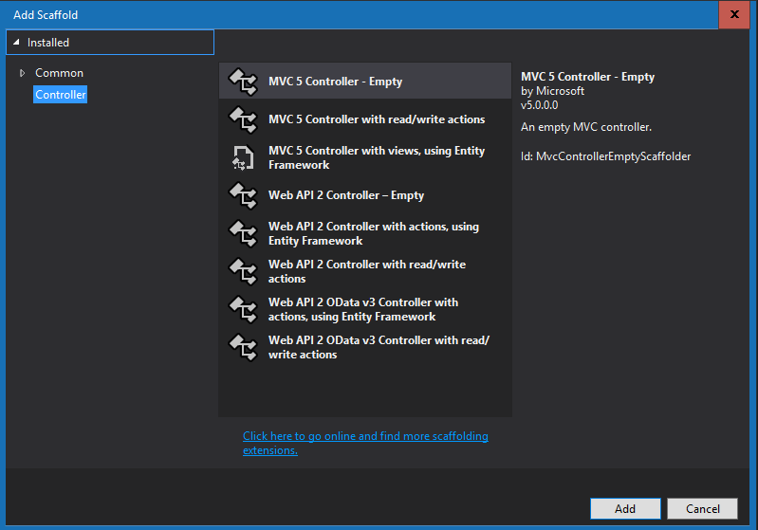
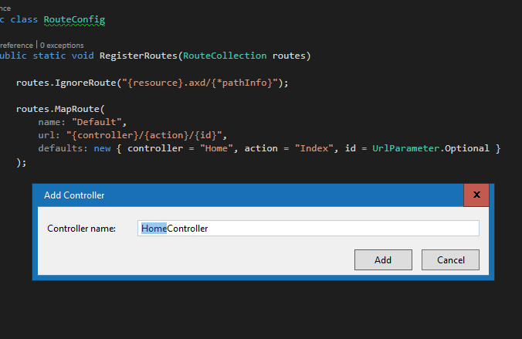
ADD CONTROLLER
Notice that the first part of the controller name is highlighted in the Add Controller dialog. Every controller name must end with the suffix Controller. For example, you can create a controller named HomeController but not a controller named Home.

Slide 14
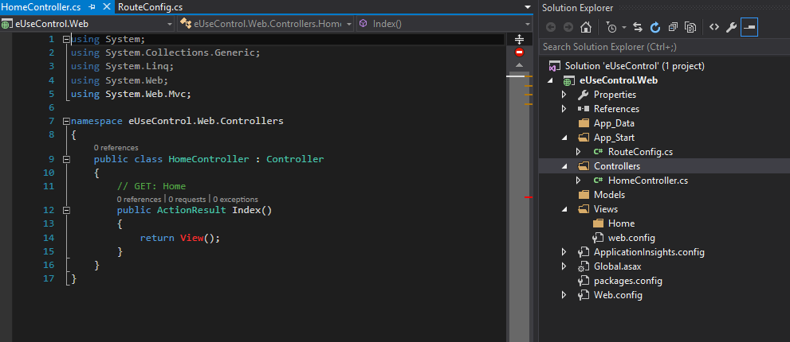
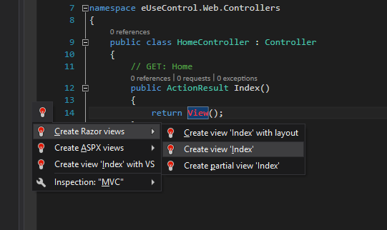
ADD CONTROLLER

Slide 15
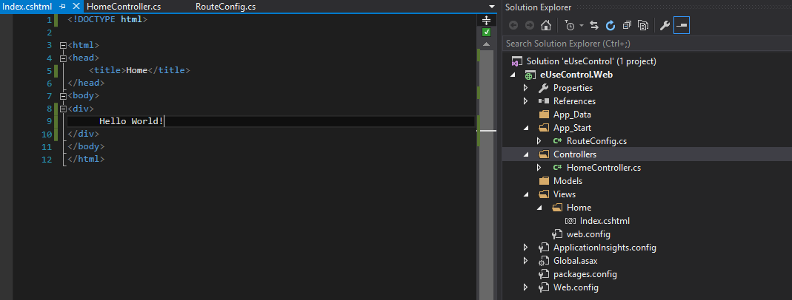
EDITING VIEW

Slide 16
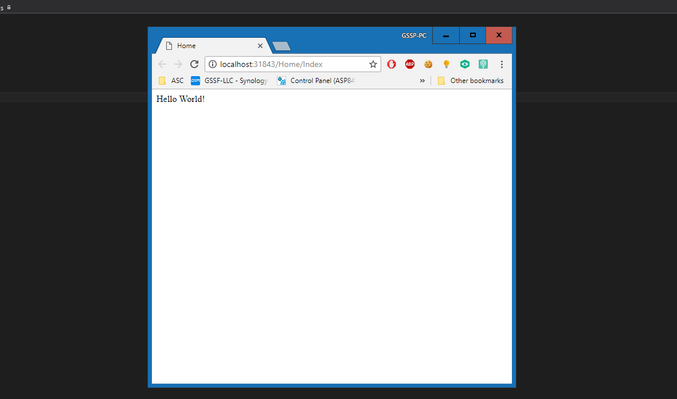

Slide 17
REFS
https://docs.microsoft.com/en-us/aspnet/mvc/overview/
http://www.tutorialsteacher.com/mvc/asp.net-mvc-tutorials
https://habrahabr.ru/post/175999/
https://habrahabr.ru/post/176001/

Slide 18
BOOTSTRAP
ASP.NET Design Integration

Slide 19
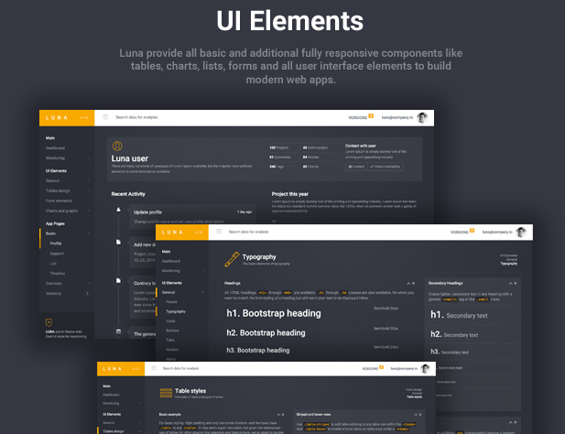

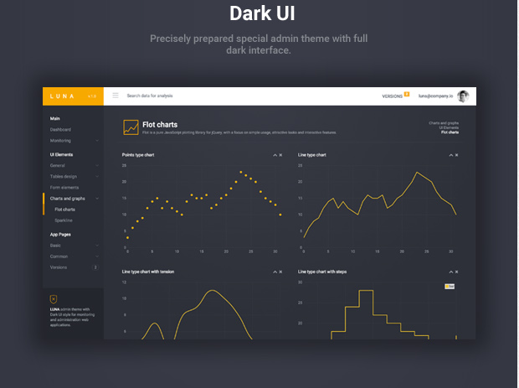
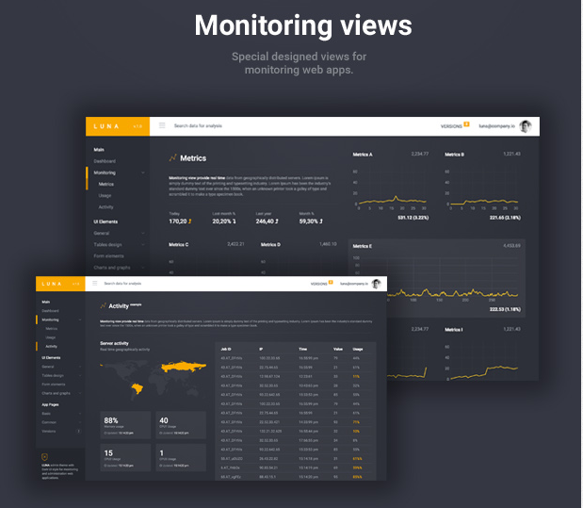
LUNA ADMIN THEME v1.3

Slide 20
ABOUT
LUNA Admin Theme is a premium admin theme with flat and dark design concept. It is fully responsive admin theme built with latest Bootstrap 3+ Framework, HTML5 and CSS3, Media query. It can be used for monitoring or administration web applications, project management system, admin dashboard, application backend or other custom project.
We are release continuous long term updates and many new features will be coming soon in the near future updates. Once you purchased LUNA, you will be entitled to free download of all updates.
URL: https://wrapbootstrap.com/theme/luna-responsive-admin-theme-WB0J69TPB

Slide 21
REFS
Bootstrap: http://getbootstrap.com/
jQuery: http://jquery.com/
jQueryUI: http://jqueryui.com/
DataTables: https://datatables.net/
Flot: http://www.flotcharts.org/
Pace: http://github.hubspot.com/pace/docs/welcome/
Sparkline: http://omnipotent.net/jquery.sparkline/#s-about
Nestable: https://github.com/dbushell/Nestable
PerspectiveMockup: http://www.pixeden.com/psd-mock-up-templates/the-new-macbook-psd-mockup
Roboto: https://www.google.com/fonts/specimen/Roboto
Toastr: https://github.com/CodeSeven/toastr
Timeline: http://codyhouse.co/gem/vertical-timeline/
meteor: https://www.meteor.com/
d3: http://d3js.org/
moment: http://momentjs.com/
flowRouter: https://github.com/kadirahq/flow-router
dataMaps: http://datamaps.github.io/
Switchery: http://abpetkov.github.io/switchery/
Summernote: http://summernote.org/
Bootstrap checkbox: https://github.com/flatlogic/awesome-bootstrap-checkbox
Select2: https://select2.github.io/
UI-select: https://github.com/angular-ui/ui-select
Typeahead: https://github.com/bassjobsen/Bootstrap-3-Typeahead
ChartJS: http://www.chartjs.org/
CSS Loaders: https://github.com/lukehaas/css-loaders

Slide 22
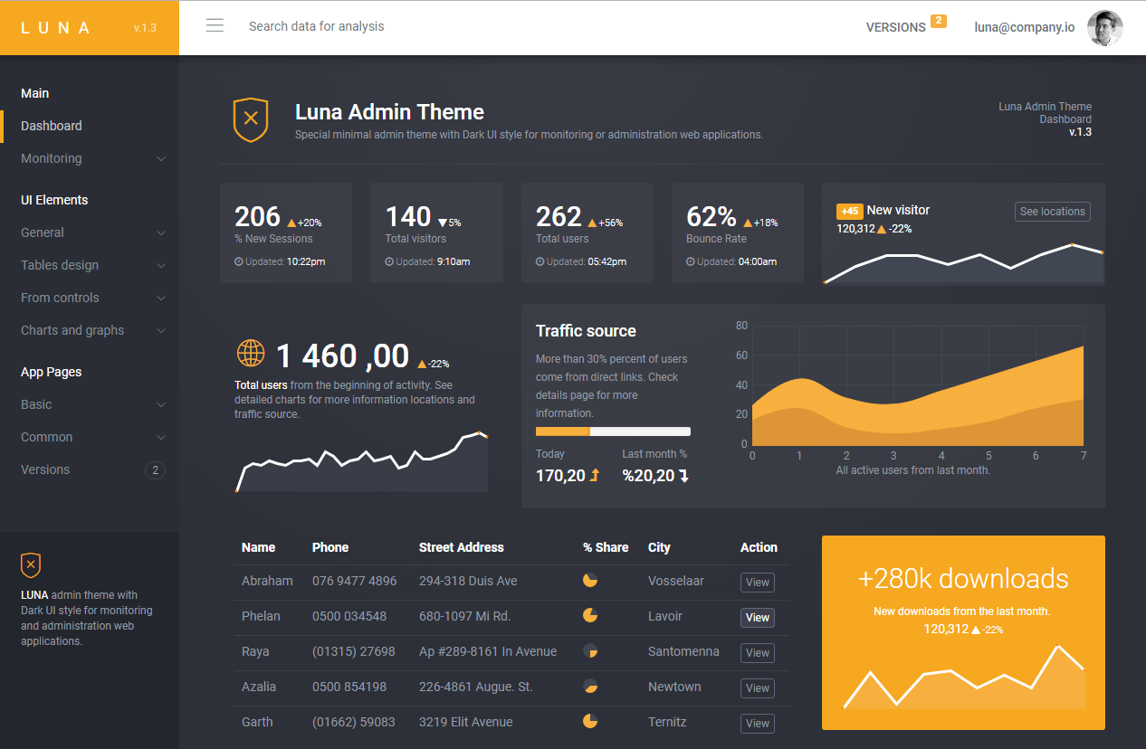

Slide 23
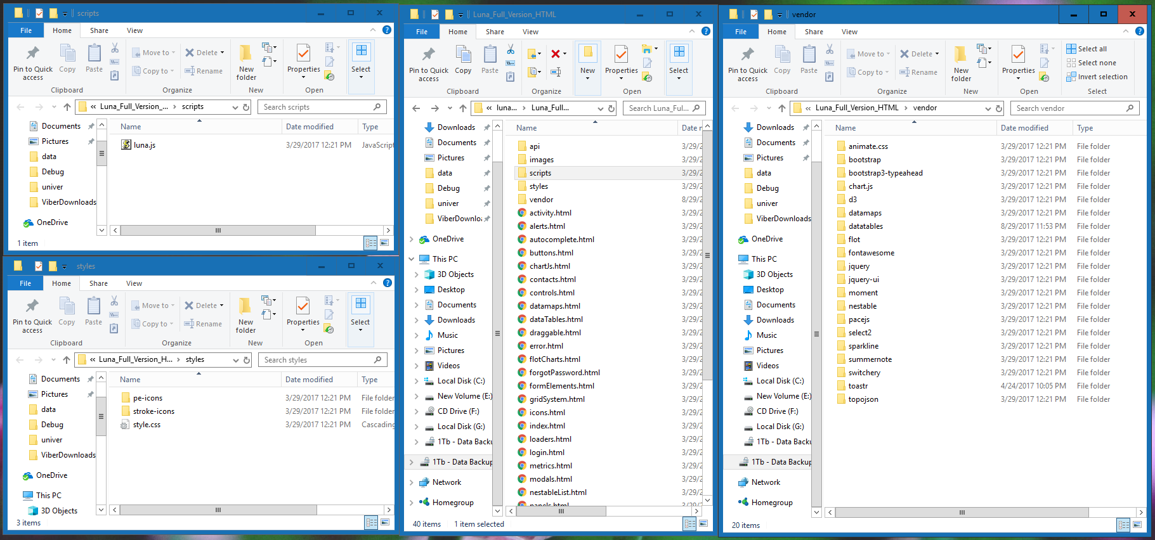

Slide 24
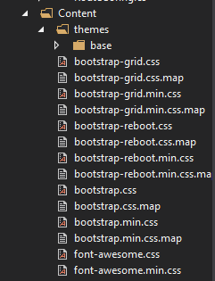
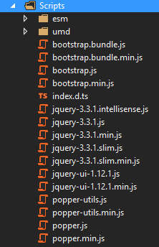
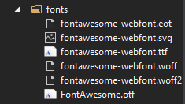
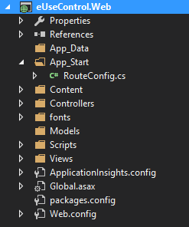
CONFIG

Slide 25
BUNDLE
<link rel="stylesheet" href="vendor/bootstrap/dist/css/bootstrap.css" />
<script src="vendor/bootstrap/dist/js/bootstrap.min.js"></script>
// Bootstrap style
bundles.Add(new StyleBundle("~/bundles/bootstrap/css").Include(
"~/Content/bootstrap.min.css", new CssRewriteUrlTransform()));

Slide 26
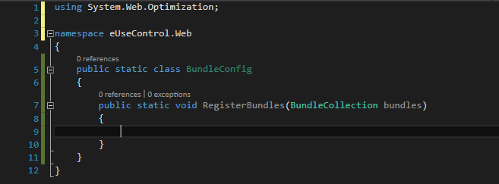
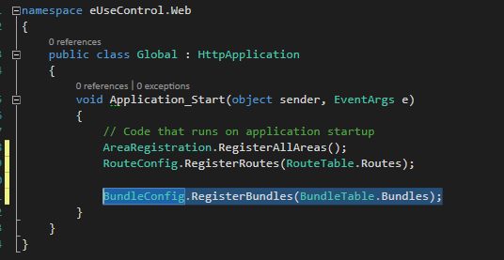
BUNDLE Config

Slide 27
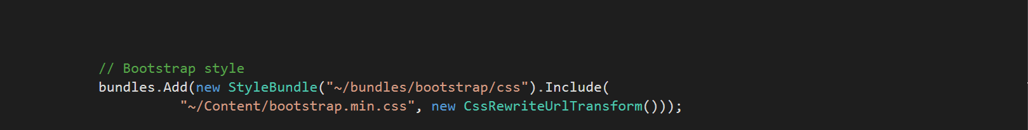
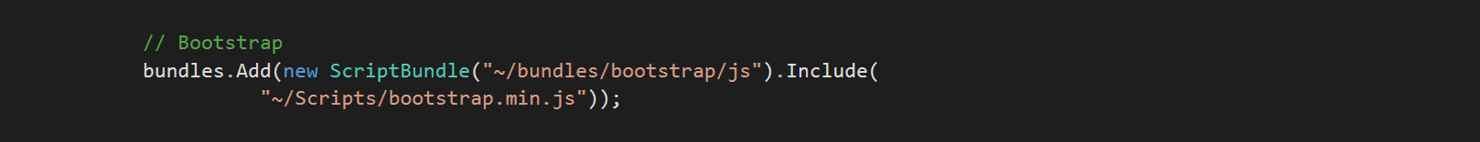
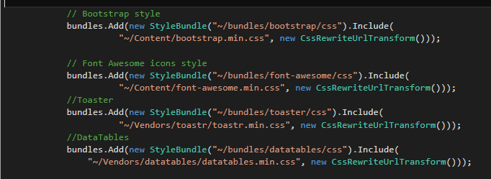

Slide 28
ADAPT TEMPLATE
Step1: In Views folder create a empty CSHTML file with name _ViewStart.chtml
Step2: Write in file @{
Layout = "~/Views/Shared/_Layout.cshtml";
}
Step3: Create folder Shared with file _Layout.

Slide 29
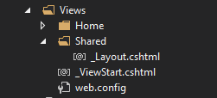
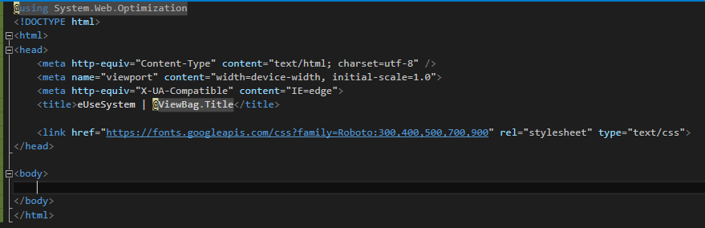

Slide 30
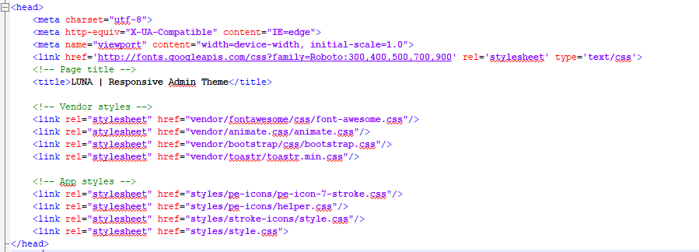
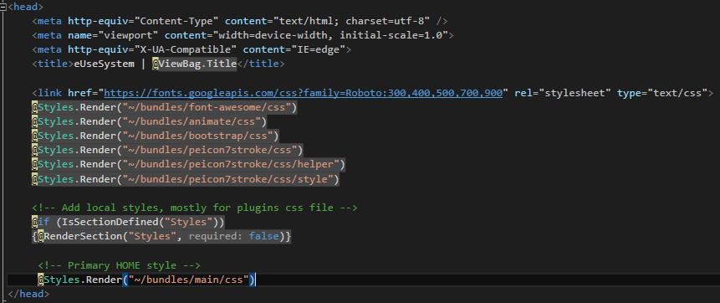
CONFIG LAYOUT

Slide 31
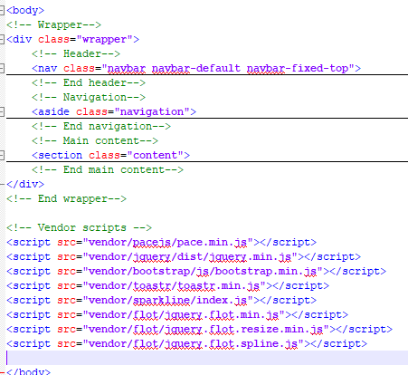
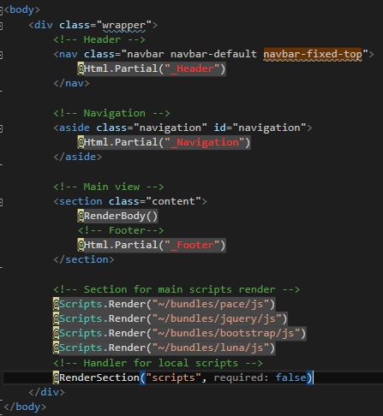

Slide 32
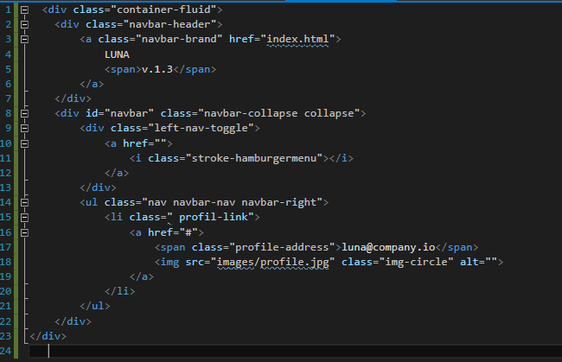
_Header

Slide 33
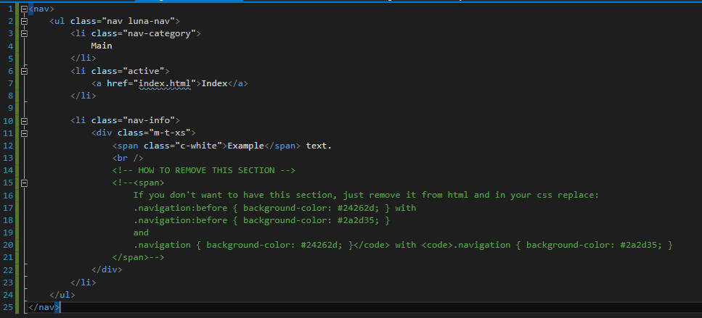
_Navigation

Slide 34
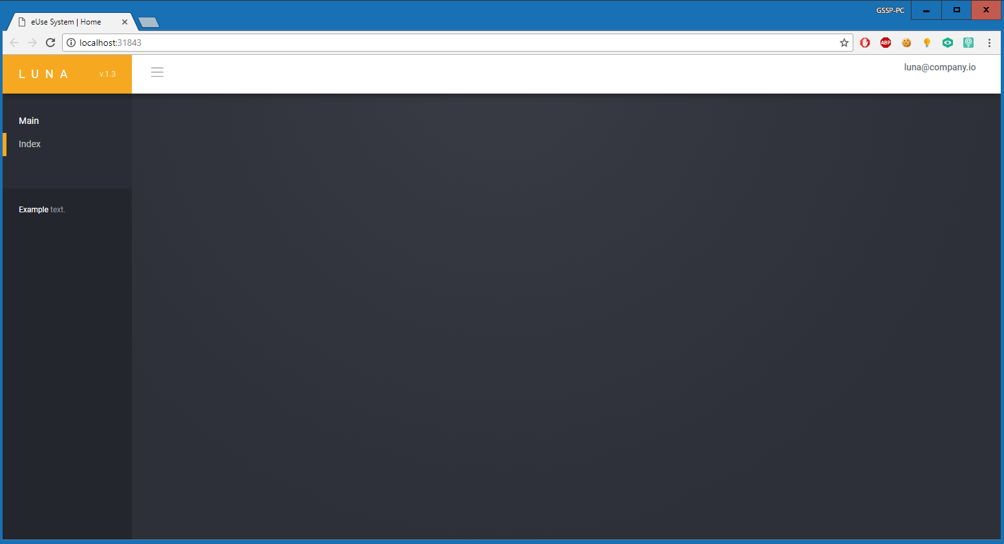
FINAL

Slide 35
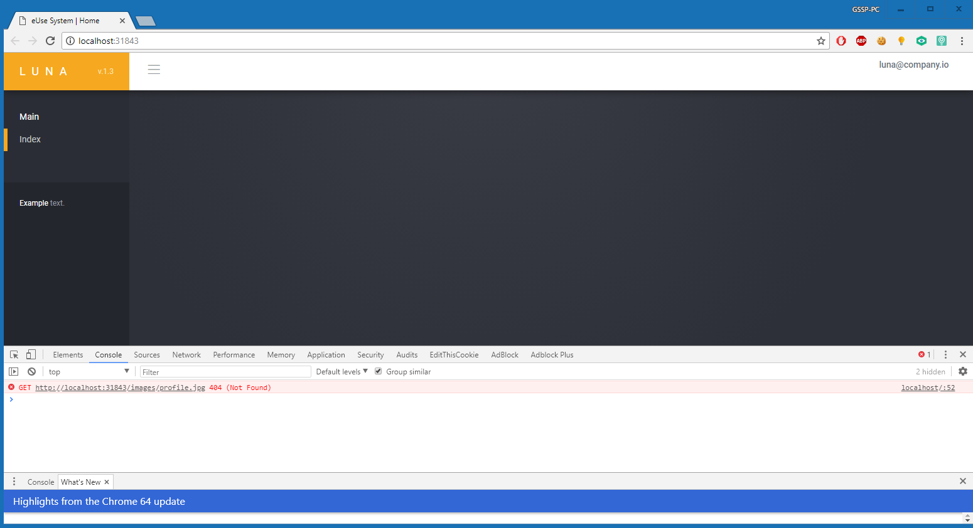

Slide 36
MODEL – VIEW – CONTROLLER (MVC)
How do we modularize the user interface functionality of a Web application.

Slide 37
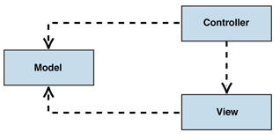
MVC
The Model-View-Controller (MVC) pattern separates the modeling of the domain, the presentation, and the actions based on user input into three separate classes.
Model. The model manages the behavior and data of the application domain, responds to requests for information about its state (usually from the view), and responds to instructions to change state (usually from the controller).
View. The view manages the display of information.
Controller. The controller interprets the mouse and keyboard inputs from the user, informing the model and/or the view to change as appropriate.

Slide 38
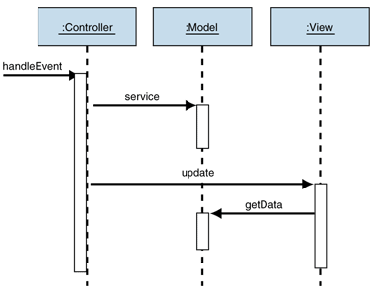
MVC Passive Model
The passive model is employed when one controller manipulates the model exclusively. The controller modifies the model and then informs the view that the model has changed and should be refreshed. The model in this scenario is completely independent of the view and the controller, which means that there is no means for the model to report changes in its state. The HTTP protocol is an example of this. There is no simple way in the browser to get asynchronous updates from the server. The browser displays the view and responds to user input, but it does not detect changes in the data on the server. Only when the user explicitly requests a refresh is the server interrogated for changes.

Slide 39
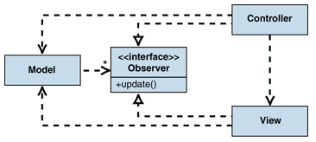
MVC Active Model
The active model is used when the model changes state without the controller's involvement. This can happen when other sources are changing the data and the changes must be reflected in the views. Consider a stock-ticker display. You receive stock data from an external source and want to update the views (for example, a ticker band and an alert window) when the stock data changes. Because only the model detects changes to its internal state when they occur, the model must notify the views to refresh the display.
However, one of the motivations of using the MVC pattern is to make the model independent from of the views. If the model had to notify the views of changes, you would reintroduce the dependency you were looking to avoid. Fortunately, the Observer pattern provides a mechanism to alert other objects of state changes without introducing dependencies on them. The individual views implement the Observer interface and register with the model. The model tracks the list of all observers that subscribe to changes. When a model changes, the model iterates through all registered observers and notifies them of the change. This approach is often called "publish-subscribe."

Slide 40
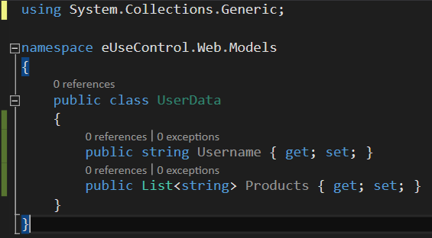
IMPLEMENTING
Create a class in Model folder.
Define some auto property ( {get; set;} ) for our future data.

Slide 41
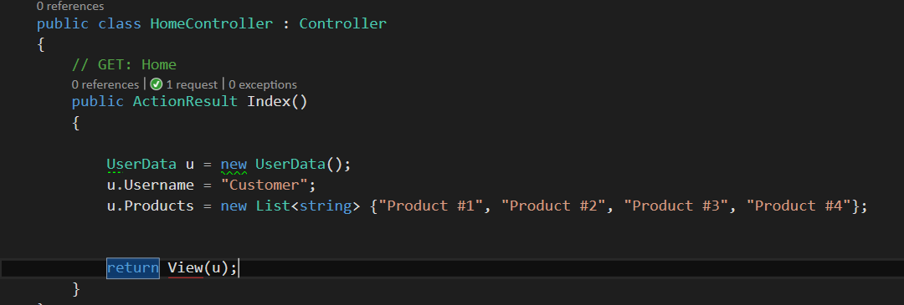
IMPLEMENTING
Call and define Class in Controller.
Set Data to the new defined Class.
Send new Object to View.

Slide 42
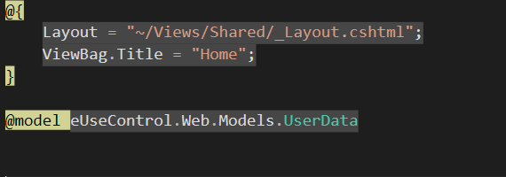
IMPLEMENTING
Define Model in View.

Slide 43
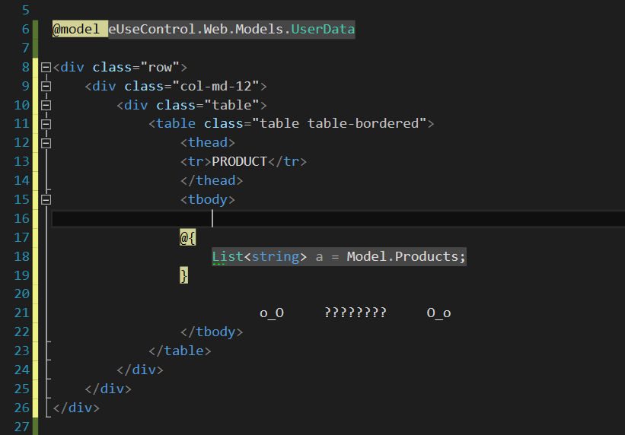
SHOW DATA?
Define a bootstrap Table.
Call Object referenced in Model.
How to enumerate? How to Show/Print string in table body?

Slide 44
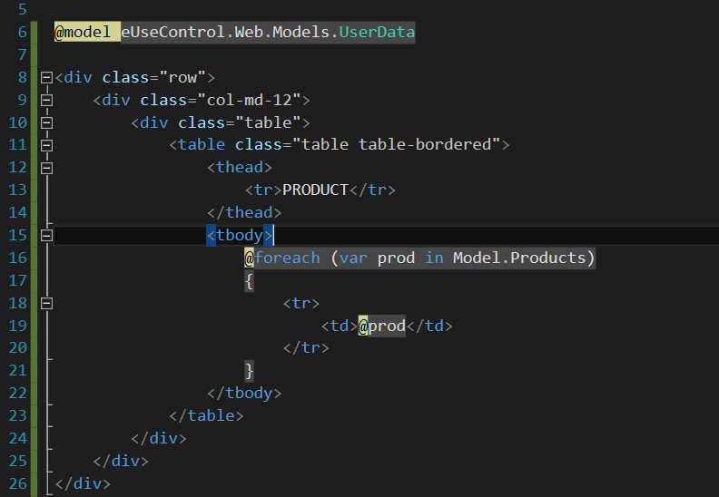
what @ ?

Slide 45
"special" ASP.NET tags
<%# %>
<%= %>
<%@ %>
<%$ %>
<%@ %> is a Directive for ASP.NET Web Pages. Used for pages and controls to configure page/control compiler settings (<%@ Control Inherits="MyParentControl" %>).
<%@ %> is also an Application Directive. Used to specify application-specific settings for global.asax. Distinct from the page directives as it only uses a different tag set.
<% %> is a Code Render Block (for inline code). One of 4 forms of Embedded Code Blocks. Used for inclusion of server-side code to the Render() method (<% x = x + 1; %>) of the generated class. Format: single/multiline or multiple-linked (e.g. if/then/else interspersed with html) but cannot be used to declare functions.
REF: https://stackoverflow.com/questions/649428/asp-net-special-tags https://stackoverflow.com/questions/14525811/asp-net-mvc-syntax

Slide 46
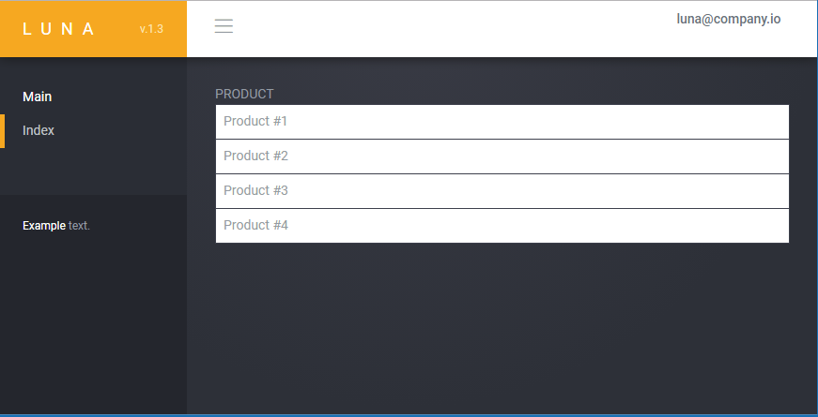
Username?

Slide 47
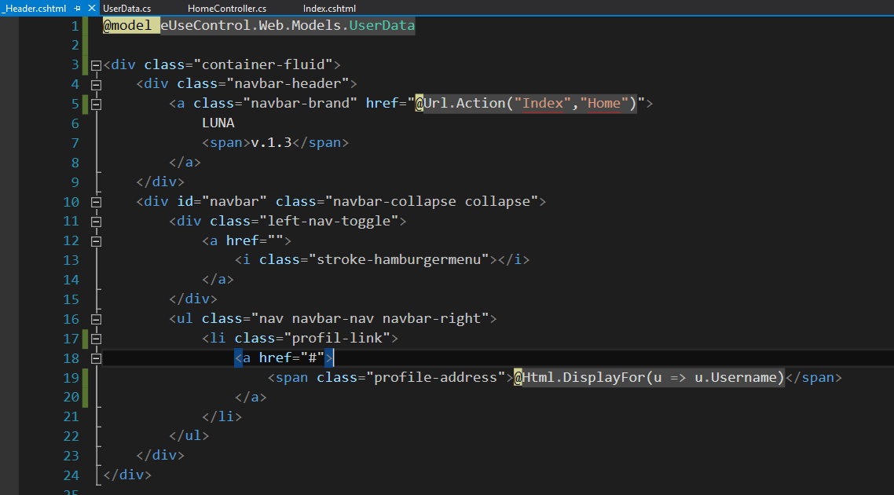
_Header

Slide 48


Slide 49
Post Data < > Controller
"BeginForm()" is an extension method that writes an opening "<form>" tag to the response. "BeginForm()" is an extension method for both HtmlHelper and AjaxHelper classes. It returns an MVCForm object from both HtmlHelper and AjaxHelper class instances so there is not much difference but the AjaxHelper method submits the form asynchronously using JavaScript.
There are two types of the BeginForm() extension methods, they are,
Html.BeginForm()
Ajax.BeginForm()
using (Html.BeginForm(“Action", “Controller", FormMethod.Post, new { autocomplete = "off" }))
{
//Html Form
}

Slide 50
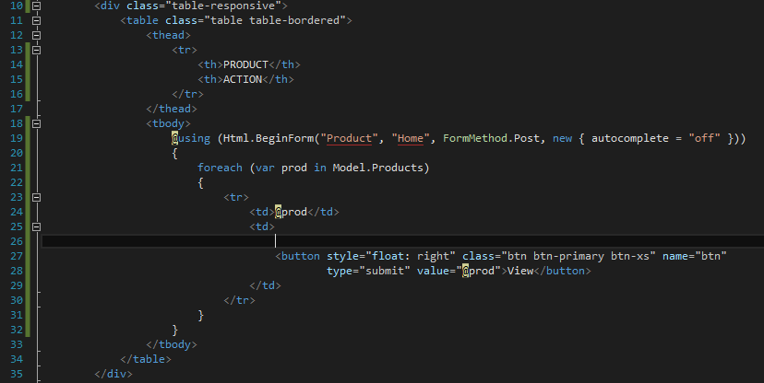
IMPLEMENT ACTION

Slide 51

VIEW

Slide 52

HTML – is BeginForm here?

Slide 53

Controller

Slide 54

REDIRECT

Slide 55

CONTROLLER

Slide 56

VIEW

Slide 57

HACK? O_o

Slide 58


Say QueryString again!

Slide 59

AJAX

Slide 60


JavaScript

Slide 61
A Data Model & Business Layer
How to re-use components to make development more intuitive?

Slide 62

Introduction
By splitting the solution into 3 logical layers:
Presentation
Business logic
Data access
We better our development efforts and increase maintainability.
While the core idea is to develop a model that supports in-built state management, first we need to become familiar with some terminology we will use in this article to get ahead.

Slide 63
Domain and Model Objects
With regards to an application, the domain refers to the business entities that are involved. For example, in a school application, the domain objects include Teacher, Classroom and Discipline. Domain objects can contain domain objects; a simple example being School containing Teachers. Or Teacher having more than one Disciplines.
The model of an application refers simply as to the way in which domain objects are described. For example, for the domain object Student, the model object will consist of Name, Class, Disciplines and Grades.
Note that for every domain object, we should have at least one model object.
The domain objects reside in the business logic layer. The model objects act as a sort of bridge between the business logic layer and the actual data access layer.

Slide 64

State Management
All entities in a domain undergo some sort of state transition. Initially they have to be created, later on fetched, modified and saved and at some point in time, deleted.
By encapsulating the functionality required to create, save, load, update and delete domain objects, we arrive at a solution that allows one to focus on the business logic involved. And moreover, as the technique is re-usable, this speeds up development.

Slide 65
Implementing
All the layers are implemented as class libraries.
The main application layers are:
[solution].Domain - The domain layer
[solution].Model - The model layer
[solution].Data - The data access layer
[solution].Web- The application's presentation layer

Slide 66

STEP #1 to …

Slide 67


Slide 68

REFERENCES

Slide 69


Slide 70


Slide 71

BL Layer

Slide 72


BL Layer

Slide 73


DOMAIN

Slide 74

ULoginData

Slide 75


CALL > BL

Slide 76

PROCESS - BL

Slide 77
Entity Framework
an open-source ORM framework for .NET applications

Slide 78

EF Basic
Entity Framework is an object-relational mapper (O/RM) that enables .NET developers to work with a database using .NET objects. It eliminates the need for most of the data-access code that developers usually need to write.
Prior to .NET 3.5, we (developers) often used to write ADO.NET code or Enterprise Data Access Block to save or retrieve application data from the underlying database. We used to open a connection to the database, create a DataSet to fetch or submit the data to the database, convert data from the DataSet to .NET objects or vice-versa to apply business rules. This was a cumbersome and error prone process. Microsoft has provided a framework called "Entity Framework" to automate all these database related activities for your application.

Slide 79
EF Feature
Cross-platform: EF Core is a cross-platform framework which can run on Windows, Linux and Mac.
Modelling: EF (Entity Framework) creates an EDM (Entity Data Model) based on POCO (Plain Old CLR Object) entities with get/set properties of different data types. It uses this model when querying or saving entity data to the underlying database.
Saving: EF executes INSERT, UPDATE, and DELETE commands to the database based on the changes occurred to your entities when you call the SaveChanges() method. EF also provides the asynchronous SaveChangesAsync() method.
Built-in Conventions: EF follows conventions over the configuration programming pattern, and includes a set of default rules which automatically configure the EF model.

Slide 80

Basic Workflow in EF

Slide 81



EF SetUp

Slide 82

EF CONTEXT

Slide 83

EF MODEL
[Key]
Entity Framework relies on every entity having a key value that it uses for tracking entities. One of the conventions that code first depends on is how it implies which property is the key in each of the code first classes. That convention is to look for a property named “Id” or one that combines the class name and “Id”, such as “UserId”. The property will map to a primary key column in the database.

Slide 84

EF MODEL
[Required]
The Required annotation tells EF that a particular property is required.
Adding Required to the Title property will force EF (and MVC) to ensure that the property has data in it.

Slide 85

EF MODEL
MaxLength and MinLength or ObjectLeght
The MaxLength and MinLength attributes allow you to specify additional property validations, just as you did with Required.
Here is the BloggerName with length requirements. The example also demonstrates how to combine attributes.

Slide 86

EF CONTEXT
An abstract function cannot have functionality. You're basically saying, any child class MUST give their own version of this method, however it's too general to even try to implement in the parent class.
A virtual function, is basically saying look, here's the functionality that may or may not be good enough for the child class. So if it is good enough, use this method, if not, then override me, and provide your own functionality.

Slide 87

WEB. CONFIG
<connectionStrings>
</connectionStrings>
SQL Server Connection Strings for ASP.NET Web Applications
https://msdn.microsoft.com/en-us/library/jj653752(v=vs.110).aspx

Slide 88

WEB. CONFIG
name="eUseControl" – same as in DbContext
connectionString="Data Source=DESKTOP-2F7PD0R\SQLSERVER;

Slide 89


MSSQ DB

Slide 90



MSSQ DB
SQL Server Management Studio
SQL Server 2014 Enterprise Edition 27HMJ-GH7P9-X2TTB-WPHQC-RG79R
SQL Server 2014 Standard Edition P7FRV-Y6X6Y-Y8C6Q-TB4QR-DMTTK

Slide 91


_Layout_Blank
@{
Layout = "~/Views/Shared/_Layout_Blank.cshtml";
ViewBag.Title = "Login";
}

Slide 92

LOGIN

Slide 93



Slide 94


LOGIN

Slide 95


EF DB

Slide 96

EF FUNCTION
http://www.entityframeworktutorial.net/entityframework6/introduction.aspx
http://www.entityframeworktutorial.net/querying-entity-graph-in-entity-framework.aspx

Slide 97
Object Auto Mapping
AutoMapper

Slide 98

What is AutoMapper?
AutoMapper is an object-object mapper. Object-object mapping works by transforming an input object of one type into an output object of a different type. What makes AutoMapper interesting is that it provides some interesting conventions to take the dirty work out of figuring out how to map type A to type B. As long as type B follows AutoMapper's established convention, almost zero configuration is needed to map two types.

Slide 99
Why use AutoMapper?
Mapping code is boring. Testing mapping code is even more boring. AutoMapper provides simple configuration of types, as well as simple testing of mappings. The real question may be "why use object-object mapping?" Mapping can occur in many places in an application, but mostly in the boundaries between layers, such as between the UI/Domain layers, or Service/Domain layers. Concerns of one layer often conflict with concerns in another, so object-object mapping leads to segregated models, where concerns for each layer can affect only types in that layer.

Slide 100


How to Map Obj?
USER INPUT
APP LOGIC

Slide 101


Login Controller
M1
M2

Slide 102

Now let’s start with the default mapping. To do this you just map the classes without adding any parameters. AutoMapper will automatically map properties with the same name. So in this example that would be the Credential and Password fields. This leaves the LoginIp, LoginDateTime field in ULoginData not mapped as there is not an equivalent property in the UserLogin class.

Slide 103

The syntax for a mapping is Mapper.CreateMap<T1, T2>() using the proper types. In this example T1 will be the UserLogin class and T2 will be the ULoginData class. Below is a snippet with only using the default mapping.
AutoMapper Repo - https://github.com/AutoMapper/AutoMapper
AutoMapper Doc - http://docs.automapper.org/en/stable/index.html

Slide 104
Auth & User Session

Slide 105

LOGIN
ASP.NET includes two intrinsic cookie collections. The collection accessed through the Cookies collection of the HttpRequest object contains cookies transmitted by the client to the server in the Cookie header. The collection accessed through the Cookies collection of the HttpResponse object contains new cookies created on the server and transmitted to the client in the Set-Cookie HTTP response header.

Slide 106


Slide 107

PASS
Cryptographic hash functions: these are fascinating mathematical objects which everybody can compute efficiently, and yet nobody knows how to invert them. This looks good for our problem - the server could store a hash of a password; when presented with a putative password, the server just has to hash it to see if it gets the same value; and yet, knowing the hash does not reveal the password itself.
https://security.stackexchange.com/questions/211/how-to-securely-hash-passwords
https://stackoverflow.com/questions/1054022/best-way-to-store-password-in-database

Slide 108

A user’s credentials are sent as a POST request to the server. The server authenticates the user. If the credentials are valid, the server responds with a cookie, which is set on the user’s browser and includes a SESSION ID to identify the user. The user sessions are stored in memory either via files or in the database on the server.
https://ponyfoo.com/articles/json-web-tokens-vs-session-cookies

Slide 109

STORE COOKIE
CookieGenerator
DB Validate Type
Store to DB
Return Cookie

Slide 110


GEN COOKIE
AES is an iterative rather than Feistel cipher. It is based on ‘substitution–permutation network’. It comprises of a series of linked operations, some of which involve replacing inputs by specific outputs (substitutions) and others involve shuffling bits around (permutations).

Slide 111

VALIDATE

Slide 112


Slide 113

HttpContext object will hold information about the current http request. In detail, HttpContext object will be constructed newly for every request given to an ASP.Net application and this object will hold current request specific informations like Request, Response, Server, Session, Cache, User and etc. For every request, a new HttpContext object will be created which the ASP.Net runtime will use during the request processing. A new HttpContext object will be created at the beginning of a request and destroyed when the request is completed. To know more about the use of HttpContext object in ASP.Net request processing please follow the article attached in the reference section of this article. Also, this object can be very well used in our application to solve some of problems.

Slide 114


https://metanit.com/sharp/mvc5/3.7.php

Slide 115
ASP - Action Filters
A one-to-one relationship with UI controls

Slide 116
<T> Filters
ASP.NET MVC framework supports the following action filters:
Action Filters − Action filters are used to implement logic that gets executed before and after a controller action executes. We will look at Action Filters in detail in this chapter.
Authorization Filters − Authorization filters are used to implement authentication and authorization for controller actions.
Result Filters − Result filters contain logic that is executed before and after a view result is executed. For example, you might want to modify a view result right before the view is rendered to the browser.
Exception Filters − Exception filters are the last type of filter to run. You can use an exception filter to handle errors raised by either your controller actions or controller action results. You also can use exception filters to log errors.

Slide 117

OnAction
OnActionExecuting – This method is called before a controller action is executed.
OnActionExecuted – This method is called after a controller action is executed.

Slide 118

OnResult
OnResultExecuting – This method is called before a controller action result is executed.
OnResultExecuted – This method is called after a controller action result is executed.

Slide 119

REQUEST to RESPONSE
Action Filters are additional attributes that can be applied to either a controller section or the entire controller to modify the way in which an action is executed. These attributes are special .NET classes derived from System.Attribute which can be attached to classes, methods, properties, and fields.

Slide 120

AdminMod

Slide 121

Admin Access
https://docs.microsoft.com/en-us/aspnet/mvc/overview/older-versions/hands-on-labs/aspnet-mvc-4-custom-action-filters
http://www.dotnettricks.com/learn/mvc/understanding-aspnet-mvc-filters-and-attributes

Slide 123

FIRST SELECT

Slide 124
Review of Key Objectives and Critical Success Factors
What makes company unique
What makes company successful
Shared vision
Review key undertakings of past year

Slide 125
How Did We Do?
Brief overview of performance against each objective

Slide 126
Organizational Overview
Introduction and broad goals of each organization
Any changes
Name and position
Name and position
Name and position
Name and position
Name and position

Slide 127
Top Issues Facing Company
Address any high profile issues

Slide 128
Review of Prior Goals
Financial
Competitive
Progress

Slide 129
Progress Against Goals
Summary of key financial results
Revenue
Profit
Key spending areas
Headcount

Slide 130
Revenue and Profit
Forecast vs. actual
Gross margin
Important trends
Compare company to rest of market
Use multiple slides to break out meaningful detail

Slide 131
Key Spending Areas
Research and Development
Sales and Marketing
General and Administration
Areas of improvement
Areas needing attention/caution

Slide 132
Headcount
Goals
Results

Slide 133
Goals for Next Period
Strategic undertakings
Financial goals
Other key efforts

Slide 134
Summary
Summarize key successes/challenges
Reiterate key goals
Thanks

